Slide 1
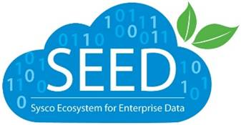

Sysco Guided Ad-Hoc Platform

Slide 2



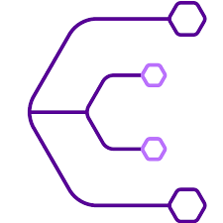
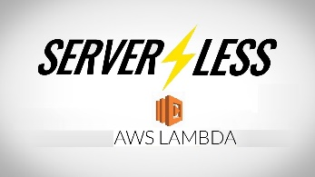

Impact of this Project
Built a Centralized and Documented Metrics Engine for Sysco
Businesses Benefitted : Category Management, Revenue Management, Pricing
Replaces a legacy tool 1010 from Sysco Data Engineering Environment due to scalability and cost factors. Cost benefits for Sysco is around $125K
First Data Product Solution at this scale for LatentView
Complying with best practices on Coding, Testing & Release
Rigorous Engineering Benchmarking done for database evaluation
Acknowledged by ‘MemSQL’ for our approach to load test
Serverless Application Stack for the first time to serve ad-hoc access
First at Sysco, First for LatentView
Customized open source load testing solution to test the functionalities
Came as a favourite amongst 3 other teams evaluating COTS at Sysco
AnswerRocket, Thoughtspot, Tableau
2

Slide 3








Integrated Analytics Platform
Guided Ad-hoc Querying (UI + API)
Data Analyst
Athena
Business user
Central Repository
Redshift
Spectrum
Optimized
Search
Datasets
Create
Data Groups
Provision Analysis
Environment
Catalogued
Data scientist
EMR

Slide 4
Key Highlights
Benchmarking
Query Engine
GAH
Testing Framework
Metrics Computation
Documentation

Slide 5

Problems and Solutions
The Application Stack solved the following pain points
No ground truth for key sales and finance metrics
Documented and authoritative metrics
Metrics Lineage Documentation, Sphinx API Documentation
Slow Platform ( No defined SLAs), Limited Storage per user
2x Faster
Original Solution was developed over 1 year+
We developed the entire solution in 6 months and made it production ready
Limited Concurrency(50),
License per user, Doesn’t scale well in cost and performance
Tested for 250 concurrent users per minute
Scales Horizontally and Pay for Use
Costs $200K annually for infrastructure and license (1010)
Project to be ~$75K per year

Slide 6
The Architecture
GAH Architecture Link
GAH Highlights
Event Driven Serverless Stack
Configuration Driven Execution
Plug and Play configuration for different metrics and different database

Slide 7



Client Impact
Central Metrics Engine
Cost Effective
Serverless Stack helps us scale horizontally. Cost Benefits for Sysco is around $125K
300+ key metrics computed at transaction level granularity
Rigorous QA (< 0.02% deviation) due to issues identified in the legacy system
As-Is/As-Was
Data as a Service
Well Documented
This is the first platform with in Sysco that breaks the access to warehouse for data and delivers all data request over a API for inspection, analysis, visualization and whole gamut of analytics use cases at this scale
All work and effort is shared via GITLAB
https://gitlab.com/Sysco-BI/unified-data-repo-backend/tree/master
Client Feedback
Work is well received by the client and clearly demonstrates value to the organization. As a proof our work, the project is being debated as a potential extension for replacing enterprise reporting solution (SAP BO)

Slide 8
Project Next Steps
Onboard business users in Production (Currently in UAT)
Extend Functionalities to meet Enterprise reporting platform capabilities (In Discussion)
Add more metrics
Enforce group specific access control lists
Optimize Metrics computation time to facilitate Near Real Time metrics (Futuristic Goal)
Enhance User Experience / POC for Voice based analytics

Slide 9
APPENDIX: SEED GAH – Infra Cost Estimate per year
Functionality | SEED GAH | Comments
Scale | 100 concurrent users per hour | Limited only by provisioned infra No limits due to application logic
Backend Database | $50,000 | Redshift (3 node ds2.8xlarge)
Application Stack | $15,000 | API + Lambda
UI | $0 | Zero Maintenance Required
Storage | $5,000 | S3, DynamoDB
Notification, Queues | $5,000 | SNS, SQS
* Estimated costs for the current capabilities and current scale required

